Slide 1
The LABB-System
Jacques Babel, Dr., Head of LABB, FSO
14.2.2019 / Swiss Longitudinal Data Fair

Slide 2
Why LABB?
Need to take profit of the new possibilities offered by the availability of the AHV number (Personal Identification Number) in many official statistics in Switzerland
FSO-Project started in 2014
LABB (Longitudinal analyses in the field of education)
Goals:
Better measure the Swiss educational system through analyses of trajectories and processes
Promote the dissemination of consistent longitudinal results

Slide 3
Members of the LABB team at FSO
Francesco Laganà, Dr.
Pascal Strubi
Jana Veselá , Dr.
Laurent Gaillard
Julie Falcon , Dr.
Jacques Babel, Dr.

Slide 4
The LABB system is constantly developing…
New data sources - registers and surveys - are regularly added
This involves:
Longitudinal linkage in order to observe trajectories in education or at the labour market interface.
Cross-sectional linkages to add contextual information to the trajectory like the migration status, parental educational, detailed geographic information or educational outcomes (e.g. employment and income).

Slide 5
Data from several sources have already been «integrated»
Source | Period | Type | Approx. number of persons in a cohort
Education statistics (2012 to 2016) | 2012-1016 | Comprehensive | 100’000
Population and household register | 2010-2016 | Comprehensive | 100’000
PLASTA from SECO | 2011-2016 | Comprehensive | 100’000*
Central Compensation Office Data + STATENT (integration in validation) | 2011-2016 | Comprehensive | 100’000*
Structural survey | 2010-2016 | Survey | 10’000 / 3’000
Earnings Structure survey (integration in validation) | 2012/2014/2016 | Survey | 20’000*
* Limitations on age or status

Slide 7
Challenges
Integration of many sources
Consistency, complexity of the various sources (e.g. “competing” sequences between sources)
Providing reference longitudinal micro data files
Implementation of a common methodology for longitudinal data processing of registers
Diffusion of files dedicated for special purposes (HSF Files, Spell Files)

Slide 8
Data availability
Production and diffusion of ready-to-use linked data to academic and institutional partners in order to facilitate analysis.
LABB Files (microdata) are available with a Data Protection Contract. Only administrative costs for academics (about CHF 100)
Many data are already linked: no need to apply for data linkages and linkages have already been checked!

Slide 9
Advantages / Drawbacks
+ Studying detailed processes: Data available on the entire cohort
+ Comparing cohorts: Each year, new cohorts added to the available data
+ Observe an attrition free process
- Data are complex (involves various types of sources with different perspectives).
- Many indirect measures. For instance a “drop-out” event is deduced from the absence of someone in a register…
=> Need to be cautious

Slide 10
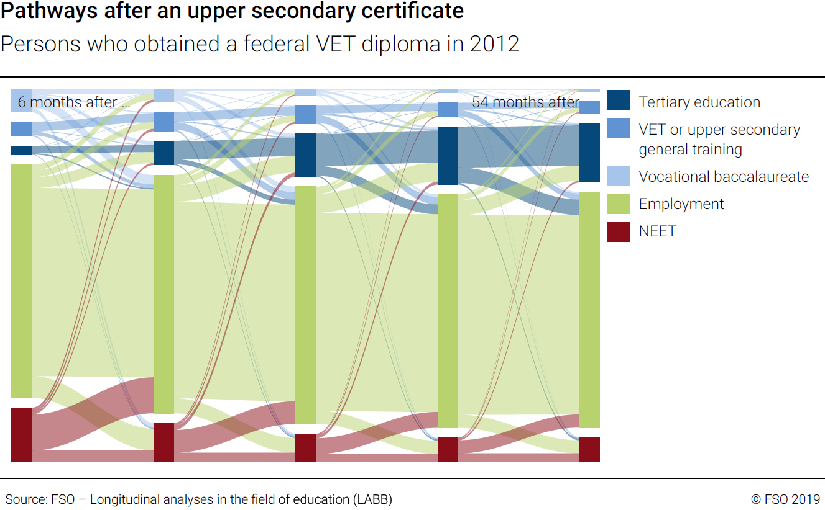
Example 1: Dynamics of trajectories

Slide 11
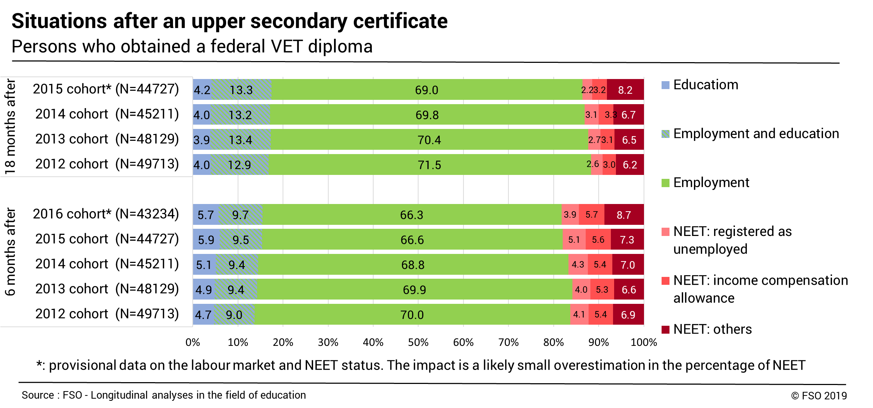
Example 2: Intercohort changes

Slide 12
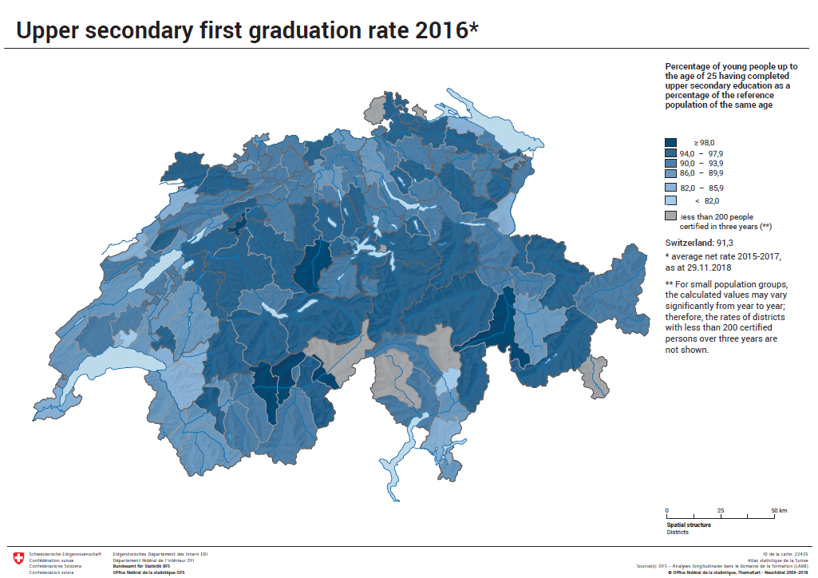
Example 3: Spatial complexity of key-indicators

Slide 13
Questions?
LABB hands-on session this afternoon
Visit: www.labb.bfs.admin.ch
Contact : eduperspectives@stat.admin.ch

